Slide 1

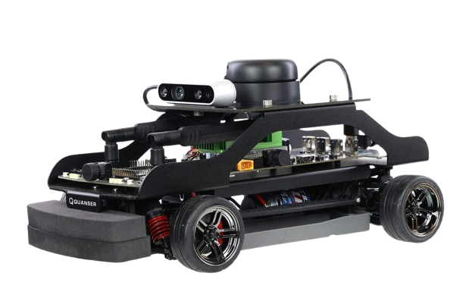
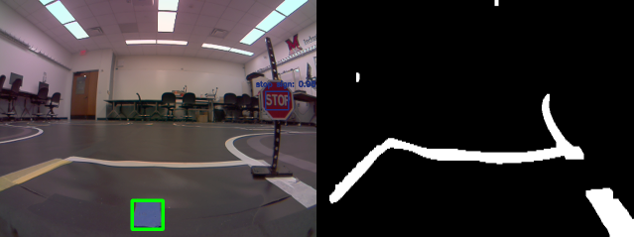
Self-Driving Car for Conference Competition
Team: Zach Copenhaver, Jakob Felts, Fred Levins, Josh Strong
Advisors: Dr. David Hartup, Dr. Bryan Van Scoy
Overview
QCar Components
A* Algorithm
Self driving vehicle
Travels between points
Emulates taxi service
This was accomplished by:
Camera feeds process information of track
Mapping of track
Live-updates while the car navigated the track
Vehicle ability to traverse track
NVIDIA Jetson TX2
Four CSI cameras
- 360 degree vision
Intel RGBD camera
LIDAR
Motor encoder
IMU sensor
Expandable IO
Shortest path between nodes
Quick computation time
g(n) current node cost
h(n) estimated cost to goal
f(n) = g(n) + h(n)
Camera Implementation
Controls feed set to binary image
Checks the location of white pixels
Adjust angle based on error
YOLO trained on COCO dataset
Cv2 DNN to single pass itemize objects in frames predicts stop signs
Confidence threshold at 60% and non-max suppression at 40%
Node detection with blue masking
Motor Controls
Motors have no bound on maximum speed
Speed value of 0.066 works best for our cases
Servo angle ranges from -0.5 to 0.5 radians (~28 degrees)
Vehicle Operations
Given start and end destinations
Find shortest path
v = kff*vt + kp*∆v+∫ki*∆v*dt
Run function to travel to next node
Visual Representation
References
Check visual feeds to update position and predict objects
https://www.quanser.com
https://github.com/vanscoy/qcar
https://opencv.org/about/
https://arxiv.org/pdf/1506.02640.pdf
https://doi.org/10.1109/cvpr.2016.91
https://cocodataset.org/
If path has not been completed, continue to next node
Node and YOLO feeds
Controls feed

